Slide 1
Network+ Guide to Networks Eighth Edition
Chapter 9
Network Risk Management
© 2019 Cengage. All Rights Reserved. May not be copied, scanned, or duplicated, in whole or in part, except for use as permitted in a license distributed with a certain product or service or otherwise on a password-protected website for classroom use.

Slide 2
Objectives (1 of 2)
9.1 Identify people, technology, and malware security risks to a network
9.2 Describe tools used to evaluate the security of a network
9.3 Discuss physical security methods that prevent and detect intrusions

Slide 3
Objectives (2 of 2)
9.4 Configure devices on a network for increased security
9.5 Describe various security policies and explain how they can guide users’ activities on a network

Slide 4
Security Risks (1 of 2)
Hacker:
Originally meant someone who masters the inner workings of computer hardware and software in an effort to better understand them
Today, hacker is used to describe an individual who gains unauthorized access to systems
Hacker categories:
White hat hacker—I T security experts hired by organizations to identify security vulnerabilities
Sometimes called an ethical hacker
Black hat hacker—Groups or individuals that cause damage, steal data, or compromise privacy
Gray hat hacker—Abide by a code of ethics all their own
Might engage in illegal activity but their intent is to educate and assist

Slide 5
Security Risks (2 of 2)
Vulnerability
Weakness of a system, process, or architecture
Exploit
Means of taking advantage of a vulnerability
Zero-day exploit or zero-day attack
Taking advantage of undiscovered software vulnerability
Exploit before software developer is aware of the vulnerability
Malicious and determined intruders may use one technique
Which allows them to use a second technique, which then supports a third technique, and so on

Slide 6
People Risks (1 of 3)
More than half of all security breaches are caused by human errors, ignorance, and omissions
Social engineering
Strategy to gain password
Common types of social engineering:
Phishing
Baiting
Quid pro quo
Tailgating

Slide 7
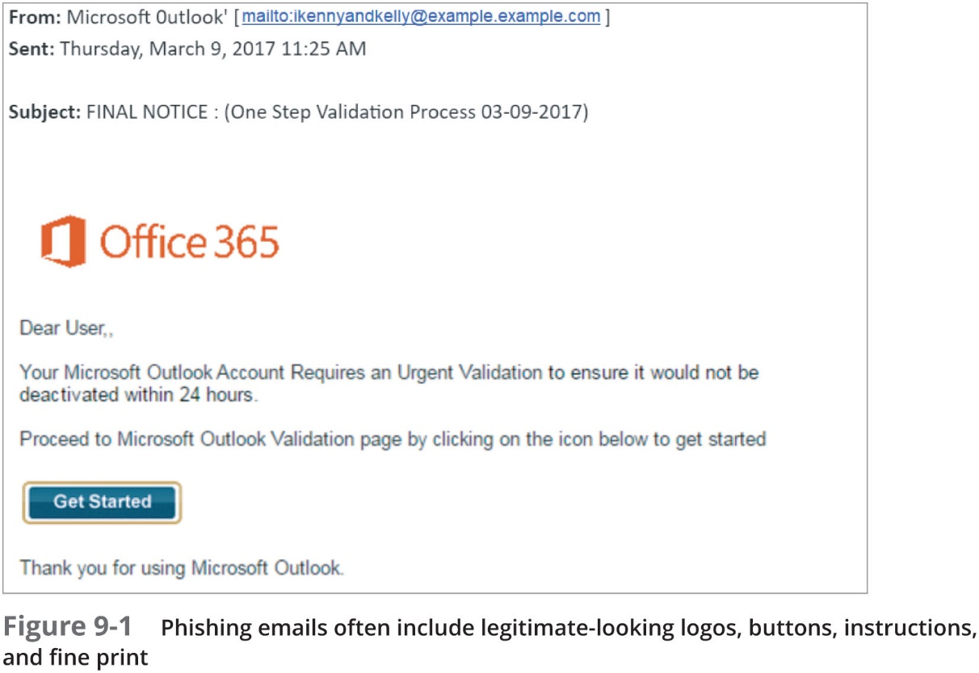
People Risks (2 of 3)

Slide 8
People Risks (3 of 3)
Most important defense against social engineering
Employee training
Insider threat:
Someone who is trusted by an organization
May have or develop malicious intent
Measures to reduce insider threat risks:
Background checks for new hires
Principle of least privilege—Given minimal access to do their job
Checks and balances on employee behavior
D L P (data loss prevention) solution that identifies sensitive data and prevents it from being copied or transmitted off the network

Slide 9
Technology Risks (1 of 7)
Risks inherent in network hardware and design:
Spoofing attack—Impersonation of MAC addresses
Denial-of-service (DoS) attack
Hacker issues flood of broadcast ping messages
Distributed DoS (D DoS) attack
Orchestrated through several sources, called zombies
Distributed reflector DoS (D R D S) attack
A D DoS attack bounced off of uninfected computers, called reflectors, before being directed at target
Amplified D R DoS attack
Using small, simple requests that trigger very large responses from the target

Slide 10
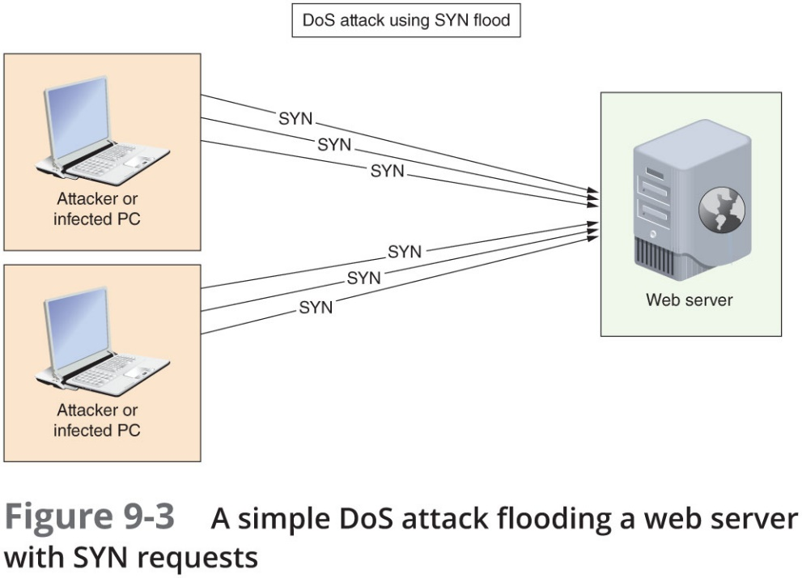
Technology Risks (2 of 7)

Slide 11
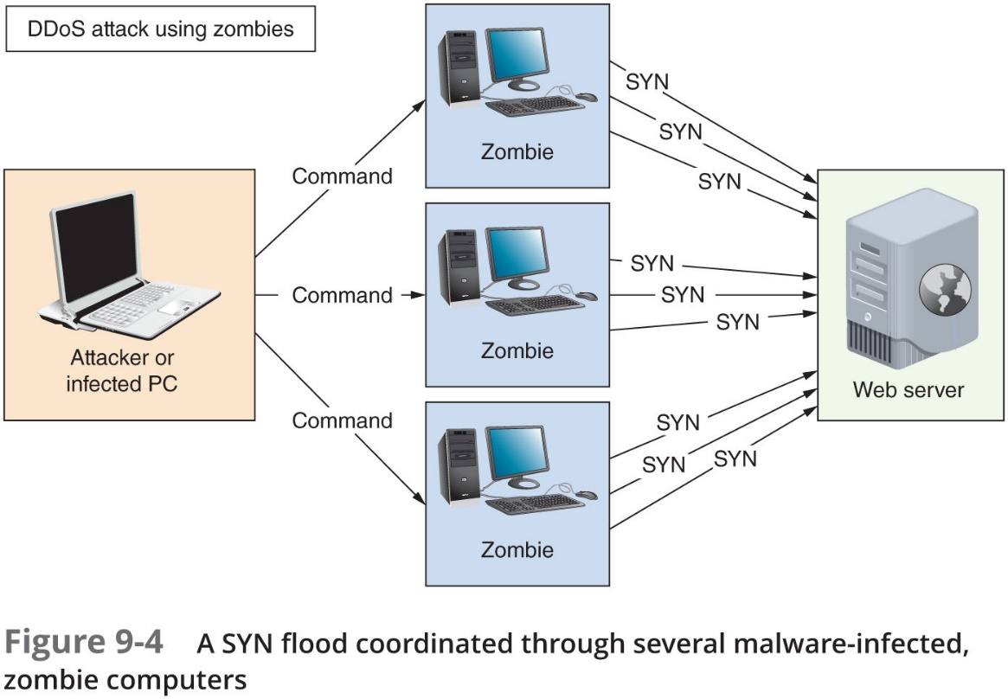
Technology Risks (3 of 7)

Slide 12
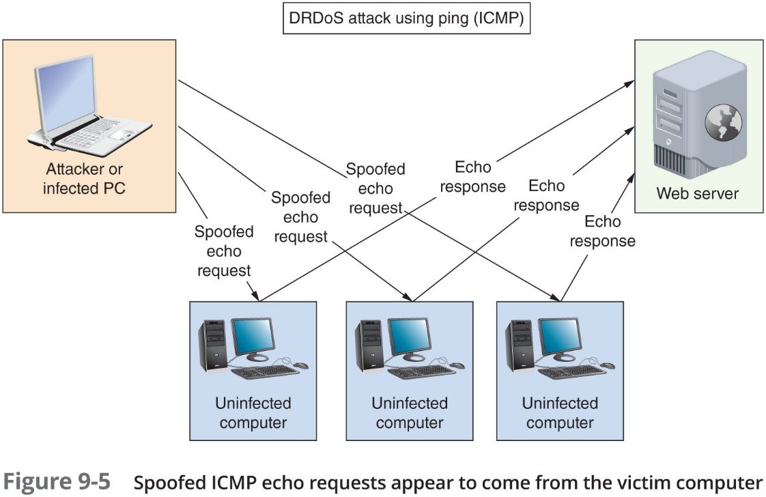
Technology Risks (4 of 7)

Slide 13
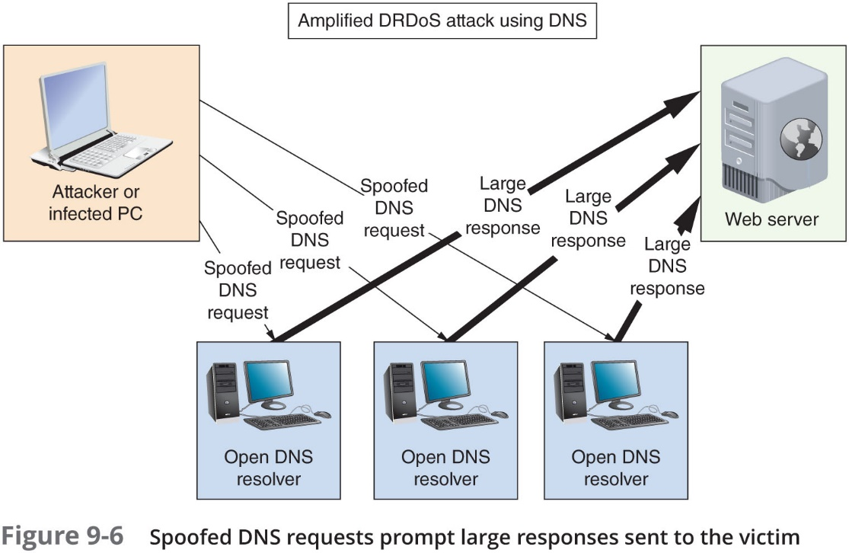
Technology Risks (5 of 7)

Slide 14
Technology Risks (6 of 7)
Risks inherent in network hardware and design (continued):
Permanent DoS (PDoS) attack
Damages a device’s firmware beyond repair
Friendly DoS attack
Not done with malicious intent
D N S poisoning (D N S spoofing)
Altering D N S records on a D N S server, an attacker can redirect Internet traffic from a legitimate to a phishing website
A R P poisoning
Attackers use faked A R P replies to alter A R P tables in the network
M i t M (man-in-the-middle) attack
Relies on intercepted transmission and can take several forms

Slide 15
Technology Risks (7 of 7)
Risks inherent in network hardware and design (continued):
Rogue D H C P server
A rogue D H C P server running on a client device could be used to implement a type of MitM attack
D H C P messages should be monitored by a security feature on switches called D CHC P snooping
Use the I p d h c p snooping command
Deauth (deauthentication) attack
Attacker sends faked deauthentication frames to the AP, client, or both to trigger the deauthentication process and knock one or more clients off the wireless network
Insecure protocols and services
F T P, H T T P, Telnet, SLIP, T F T P, S N M Pv1, and S N M Pv2
Back doors
Security flaws that allow unauthorized users to gain access to the system

Slide 16
Malware Risks (1 of 4)
Malicious software:
Program designed to intrude upon or harm system, resources
Examples: Viruses, Trojan horses, worms, bots, and ransomware
Virus:
Replicating program intent to infect more computers
Replicates through network connections or exchange of external storage devices
Trojan horse (Trojan):
Program that disguises itself as something useful
Actually harms your system

Slide 17
Malware Risks (2 of 4)
Worms
Programs that run independently and travel between computers and across networks
Bots
Program that runs automatically without requiring a person to start or stop it
Can be used to:
Damage or destroy a computer’s data or system files
Issue objectionable content
Launch DoS attacks
Open back doors for further infestation
Ransomware
A program that locks a user’s data or computer system until a ransom is paid

Slide 18
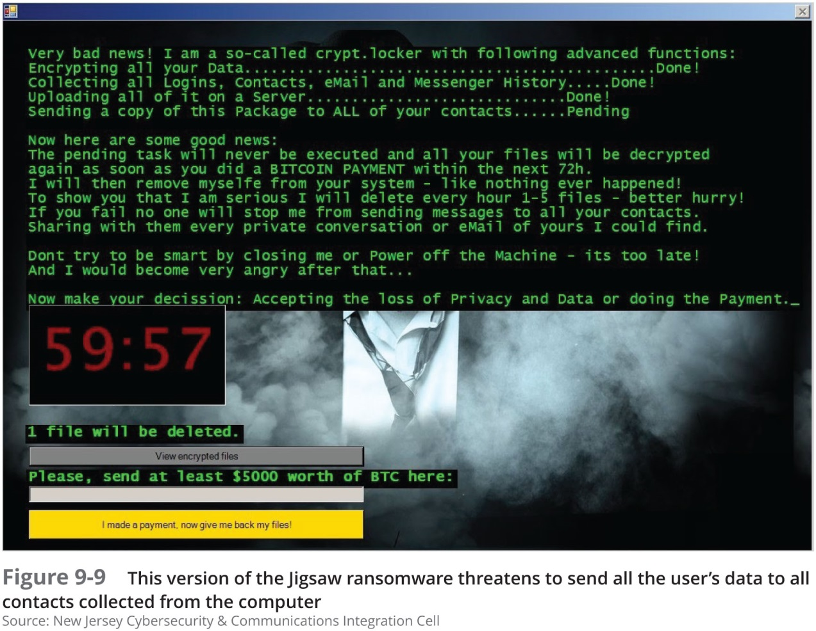
Malware Risks (3 of 4)

Slide 19
Malware Risks (4 of 4)
Malware characteristics:
Encryption
To prevent detection
Stealth
Disguised as legitimate programs
Polymorphism
Change characteristics every time they transfer to new system
Time dependence
Programmed to activate on particular date
Can remain dormant and harmless until date arrives
Logic bombs: programs designed to start when certain conditions met
Malware can exhibit more than one characteristic

Slide 20
Security Assessment
Different types of organizations have different levels of network security risk
Posture assessment:
A thorough examination of each aspect of the network to determine how it might be compromised
Should be performed at least annually
Security audit
An assessment performed by a company that has been accredited by an agency that sets network security standards

Slide 21
Scanning Tools (1 of 4)
During a posture assessment
Use some of the methods a hacker uses to identify cracks in security architecture
Three types of attack simulations
Vulnerability scanning—Two types of scans:
Authenticated —Attacker is given same access as a trusted user would have
Unauthenticated —Attacker begins on the perimeter of the network, looking for vulnerabilities that do not require trusted user privileges
Penetration testing
Uses variable tools to find network vulnerabilities and attempts to exploit them
Red team-blue team exercise
Red team conducts the attack
Blue team attempts to defend the network

Slide 22
Scanning Tools (2 of 4)
Scanning tools can be used to discover crucial information such as:
Every available host
Services, including applications and versions, running on every host
O Ss running on every host
Open, closed, and filtered ports on every host
Existence, type, placement, and configuration of firewalls
Software configurations
Unencrypted, sensitive data

Slide 23
Scanning Tools (3 of 4)
Three popular scanning tools:
N M A P (Network Mapper)
Designed to scan large networks
Provides information about network and hosts
Free to download
Nessus
Performs more sophisticated scans than Nmap
Metasploit
Combines known scanning and exploit techniques to explore potentially new attack routes

Slide 24
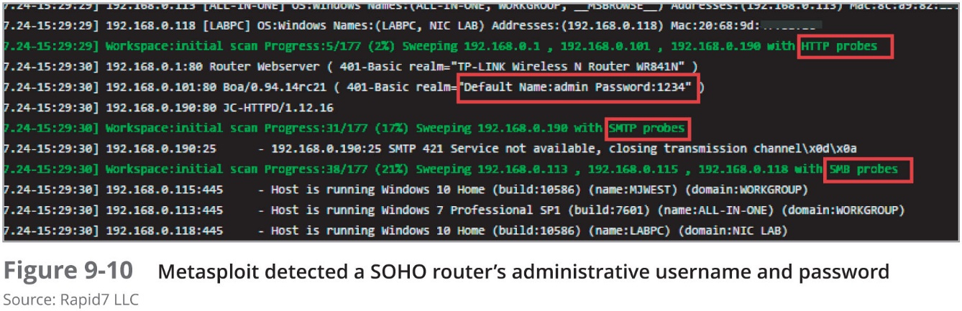
Scanning Tools (4 of 4)

Slide 25
Honeypots and Honeynets
Honeypot:
Decoy system that is purposefully vulnerable
Designed to fool hackers and gain information about their behavior
Might be given an enticing name, such as one that indicates a name server or a storage location for confidential data
Honeynet
Network of honeypots

Slide 26
Physical Security
Restrict physical access to critical components
Only trusted networking staff should have access to secure computer/data rooms
Preventative measures such as locked doors can make it more difficult for unauthorized people to get into these areas
Important to have good detection measures in place for those times when someone is able to breach a secured perimeter

Slide 27
Prevention Methods (1 of 4)
A security policy should define who has access to the computer room
Sophisticated door access controls:
Keypad or cipher locks
Cipher locks are physical or electronic locks requiring a code to open the door
Key fob
Provides remote control over locks and security systems
Access badges
Many organizations provide electronic access badges called smart cards
Smart cards can be programmed to allow owner access to some, but not all, rooms in a building
Proximity card
Do not require direct contact with a proximity reader in order to be detected
Biometrics
Scans an individual’s unique physical characteristics

Slide 28
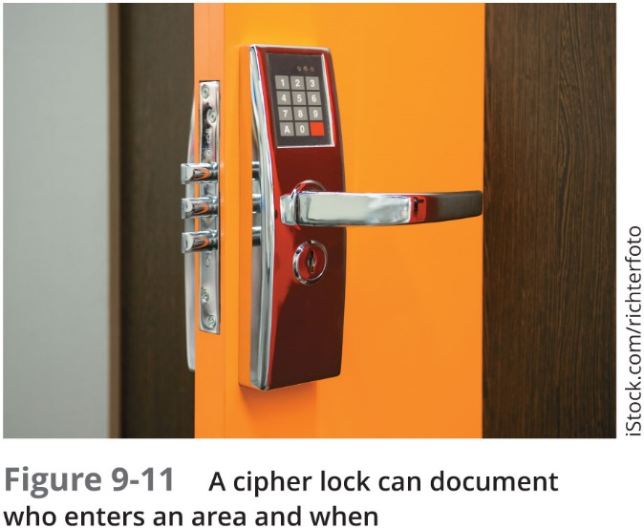

Prevention Methods (2 of 4)

Slide 29
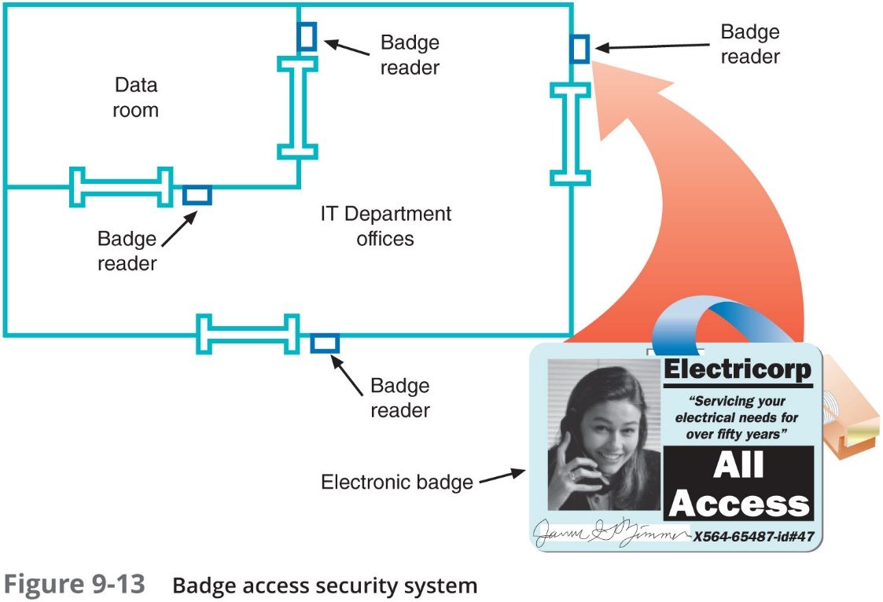
Prevention Methods (3 of 4)

Slide 30
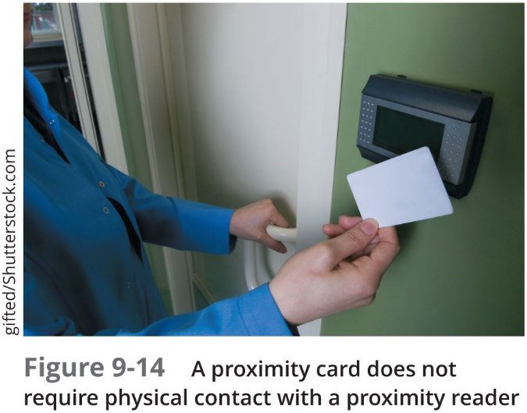
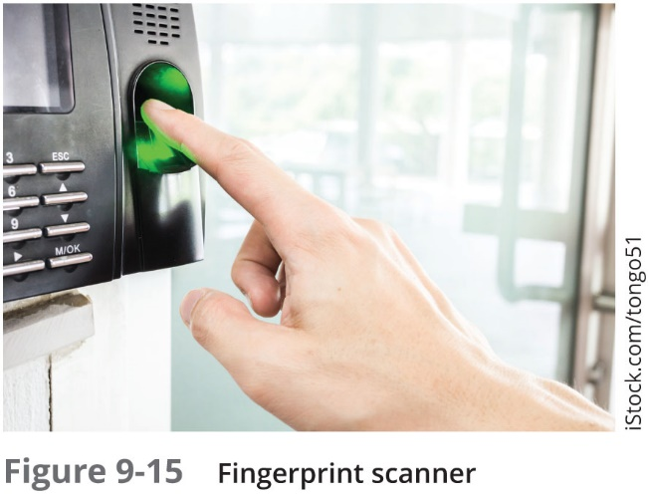
Prevention Methods (4 of 4)

Slide 31
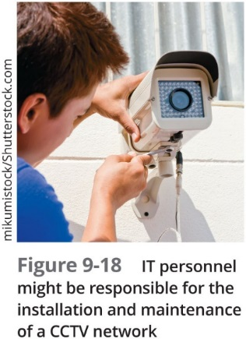
Detection Methods (1 of 3)
Methods of detecting physical intrusions:
Motion detection
Video surveillance
Tamper detection
Sensors that detect physical penetration, temperature extremes, input voltage variations, input frequency variations, or certain kinds of radiation
Asset tracking
Used to monitor the movement and condition of equipment, inventory, and people

Slide 32

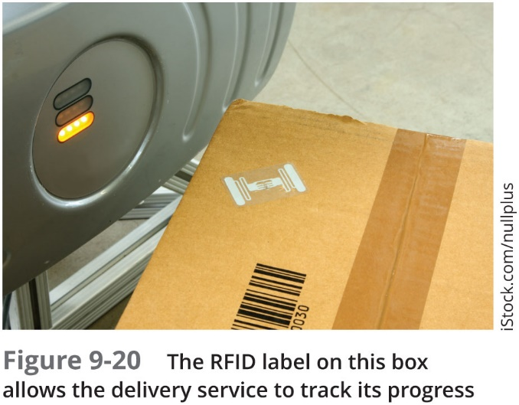
Detection Methods (2 of 3)

Slide 33
Detection Methods (3 of 3)
Important questions to ask when planning for physical security:
Which rooms contain critical systems or data and must be secured?
Through what means might intruders gain access to the facility, computer room, data room, network closet, or data storage areas?
How and to what extent are authorized personnel granted entry?
Are employees instructed to ensure security after entering or leaving secured areas?
Are authentication methods difficult to forge or circumvent?
Do supervisors or security personnel make periodic physical security checks?
Are all combinations, codes, or other access means to computer facilities protected at all times, and are those combinations changed frequently?
What is the plan for documenting and responding to physical security breaches?

Slide 34
Device Hardening
Device hardening:
Steps to secure a device from network- or software-supported attacks
Many layers of defense

Slide 35
Updates and Security Patches
Updates to applications, O Ss, and device firmware:
Fix bugs
Add new features
Close security gaps
Process of properly managing and applying security patches includes:
Discovery
Standardization
Layered security
Vulnerability reporting
Implementation
Assessment
Risk mitigation

Slide 36
Administrative Credentials
Many devices are managed through remote access connections:
Using S S H keys is more secure than using passwords
A securely encrypted key is more difficult to crack
Many devices offer the option to configure several administrative accounts with varying levels of access
Privileged user account:
The most privileged account type
Security precautions:
Limited use
Limited location
Limited duration
Limited access
Limited privacy

Slide 37
Services and Protocols
Insecure services and protocols should be disabled in a system whenever possible
To protect devices, follow these guidelines:
Use secure protocols instead of insecure protocols
Disable any running services not needed
Minimize the number of startup programs
Close T C P/I P ports on the local firewall that are not used for ongoing activities
Disable unneeded connection technologies
Remove known networks if they’re no longer needed
Disable or uninstall applications that are no longer needed

Slide 38
Hashing
Hashing
To transform data through an algorithm that reduces the amount of space needed for the data
S H A (Secure Hash Algorithm):
Most commonly used hashing algorithm
Advantage: its resistance to collisions
Versions of S H A:
S H A-0
S H A-1
S H A-2
S H A-3
S H A-2 and S H A-3 are often implemented together for increased security

Slide 39
Anti-Malware Software (1 of 3)
Effective malware protection requires:
Choosing appropriate anti-malware program
Monitoring network
Continually updating anti-malware program
Educating users
Malware leaves evidence
Some detectable only via anti-malware software

Slide 40
Anti-Malware Software (2 of 3)
Symptoms of malware:
Unexplained file size increases
Significant, unexplained system performance decline
Unusual error messages
Significant, unexpected system memory loss
Periodic, unexpected rebooting
Display quality fluctuations

Slide 41
Anti-Malware Software (3 of 3)
Key: deciding where to install software
Host-based
Server-based
Network-based
Cloud-based
Balance protection with performance impact

Slide 42
Security Policies for Users
Security policy:
Identifies security goals, risks, authority levels, designated security coordinator, and team members
Responsibilities of each team member and employee
How to address security breaches
Not included in policy:
Hardware, software, architecture, and protocols
Configuration details

Slide 43
Security Policy Goals (1 of 2)
Typical goals:
Ensure authorized users have appropriate resource access
Prevent unauthorized user access
Protect sensitive data from unauthorized access
Prevent accidental hardware and software damage
Prevent intentional hardware or software damage
Create secure environment
Withstand, respond to, and recover from threat
Communicate employees’ responsibilities
Have employees sign a consent to monitoring form

Slide 44
Security Policy Goals (2 of 2)
Strategy:
Form committee
Involve as many decision makers as possible
Assign security coordinator to drive policy creation
Understand risks
Conduct posture assessment
Rate severity and likelihood of each threat

Slide 45
B Y O D (Bring Your Own Device) (1 of 2)
B Y O D (bring your own device)
The practice of allowing people to bring their smartphones, laptops, or other technology into a facility for the purpose of performing work or school responsibilities
Variations include:
B Y O A (bring your own application)
B Y OCOC (bring your own cloud)
B Y O T (bring your own technology)
C Y O D (choose your own device)
Security and legal compliance concerns must be sufficiently addressed in clearly defined B Y O D policies

Slide 46
B Y O D (Bring Your Own Device) (2 of 2)
Part of a B Y O D policy might include on-boarding and off-boarding procedures
These configurations can be handled automatically by M D M (mobile device management) software
M D M software can:
Automate enrollment
Enforce password policies and other security restrictions
Encrypt data on the device
Sync data across corporate devices
Wipe the device
Monitor the device’s location and communications

Slide 47
A U P (Acceptable Use Policy) (1 of 2)
A U P:
Explains to users what they can and cannot do while accessing a network’s resources
Explains penalties for violations
Might describe how these measures protect the network’s security
Some restrictions might include:
Don’t do anything illegal
Don’t try to circumvent network security restrictions
Don’t market products or services to other network users
Don’t forward spam email
Don’t violate the rights of any person or organization
Don’t violate copyright, trade secret, patent, intellectual property, or other regulations

Slide 48
A U P (Acceptable Use Policy) (2 of 2)
Some restrictions might include (continued):
Don’t export software, technical information, or encryption technology
Always sign off or lock a device when not in use
Use company resources to fulfill job obligations, not personal tasks
Be aware that activities on the network can be and are monitored and may be formally audited
Immediately report any suspected compromise of confidential data or customer privacy

Slide 49
N D A (Non-Disclosure Agreement)
N D A
A security should also define what confidential and private means to the organization
If you work in an environment such as a hospital, where most data is sensitive or confidential
Security policy should classify information in degrees of sensitivity that correspond to how strictly its access is regulated

Slide 50
Password Policy (1 of 2)
Guidelines for selecting passwords should be part of a security policy
Tips for making and keeping passwords secure:
Always change system default passwords after installing new software or equipment
Do not use familiar information (name, nickname, date of birth, etc.)
Do not use any word that might appear in a dictionary
Make the password longer than eight characters
Do not repeat words or number sequences
Do not use a single letter, number, or symbol more than twice in succession
Do not use easily recognized phrases such as a line from a song, poem, or movie
Do not write down your password or share it with others

Slide 51
Password Policy (2 of 2)
Tips for making and keeping passwords secure (continued):
Change your password at least every 60 days or more frequently
Do not reuse passwords after they have expired
Use different passwords for different applications
Make it easier to keep a secure record of long, random passwords by installing and using password management software such as LastPass or KeePass

Slide 52
Privileged User Agreement
Privileged user agreement (privilege access agreement)
Addresses specific concerns related to privileged access given to administrators and certain support staff
Outlines guidelines, rules, restrictions, and consequences of violations
When accessing a privileged account
User should only stay signed into the account as long as is necessary to perform needed tasks and then sign off
Privilege users need more frequent training and reminders to avoid falling for social engineering attacks of various types
Privileged accounts may be monitored through a P A M (privileged account management) tool

Slide 53
Anti-Malware Policy
An anti-malware policy provides:
Rules for using anti-malware software
Rules for installing programs, sharing files, and using external disks
Suggestions for anti-malware policy guidelines:
Every computer should be equipped with malware detection and cleaning software
Users should not be allowed to alter or disable the anti-malware software
Users should know what to do in case their anti-malware program detects malware
An anti-malware team should focus on maintaining the anti-malware measures
Users should be prohibited from installing any unauthorized software on their systems
System wide alerts should be issued to network users notifying them of a serious malware threat and advising them how to prevent infection

Slide 54
Chapter Summary (1 of 4)
A weakness of a system, process, or architecture that could lead to compromised information or unauthorized access is known as a vulnerability
End-user awareness and training can be a monumental task that requires regular attention and due diligence
A DoS (denial-of-service) attack occurs when a legitimate user is unable to access normal network resources
Malware refers to any program or piece of code designed to intrude upon or harm a system or its resources
Every organization should assess its security risks by conducting a posture assessment

Slide 55
Chapter Summary (2 of 4)
Penetration testing uses various tools to find network vulnerabilities
Physical access to all of a network’s critical components must be restricted and controlled
Asset tracking tags can be used to monitor the movement and condition of equipment, inventory, and people
Besides securing network devices external tampering, you can take steps to secure the device from network- or software-supported attacks
Security gaps are often addressed in smaller, more frequent updates called patches
Insecure services and protocols should be disabled in a system whenever possible

Slide 56
Chapter Summary (3 of 4)
Hashing means to transform data through an algorithm that generally reduces the amount of space needed for the data
Protection against harmful code involves choosing the most appropriate anti-malware program for your environment, monitoring the network, continually updating the anti-malware program, and educating users
A security policy for network users identifies your security goals, risks, levels of authority, designated security coordinator and team members, responsibilities for each team member, and responsibilities for each employee
B Y O D (bring your own device) refers to the practice of allowing employees or students to bring their smartphones, laptops, or other technology for the purpose of performing work or school responsibilities

Slide 57
Chapter Summary (4 of 4)
An A U P (acceptable use policy) explains to users what they can and cannot do while accessing a network’s resources
Choosing a secure password is one of the easiest and least expensive ways to help guard against unauthorized access
A privileged user agreement addresses the specific concerns related to privileged access given to administrators and certain support staff
Anti-malware software along will not keep your network safe from malicious code

